Slide 1
Endava .Net Core Training
Graduates have never
been this lucky…

Slide 2
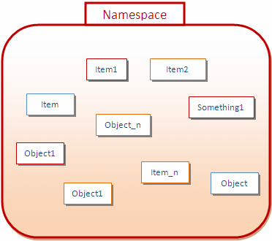
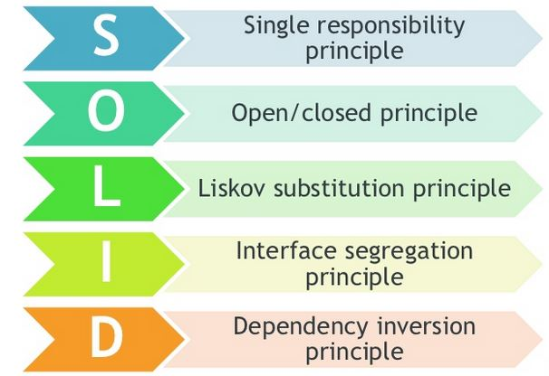
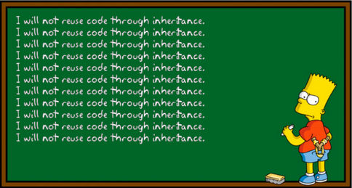
What we have achieved yesterday ?
Notes:
What about assemblies ?

Slide 3
Content
Generics
Collections
Reflection
Attributes

Slide 4
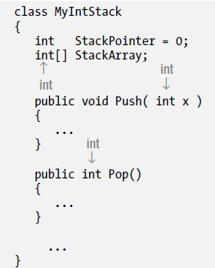
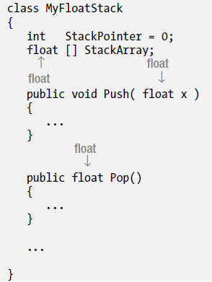
What Are Generics?
There are times when a class would be more useful if you could “distill” or “refactor” out its actions and apply them not just to the data types for which they are coded but for other types as well.
You can refactor your code and add an additional layer of abstraction so that, for certain kinds of code, the data types are not hard-coded.
Problems
You need to inspect every part of the class carefully to determine which type declarations need to be changed and which should be left alone.
You need to repeat the process for each new type of stack class you need (long, double, string, and so on). No code duplication, which is what we wanted to avoid!
After the process, you end up with multiple copies of nearly identical code, taking up additional space.
Debugging and maintaining the parallel implementations is inelegant and error-prone.
Notes:
Before we go into what are generics, let’s see some code examples to better understand why should use them
Describe above code examples – what each class does; similarities, differences
What is wrong with this design and what will be the impact on longer periods of time

Slide 5
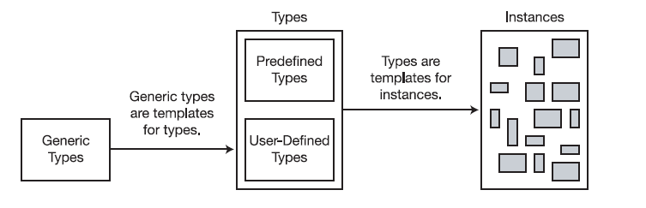
What Are Generics?
With C# 2.0, Microsoft introduced the generics features, which offer more elegant ways of using a set of code with more than one type.
Generics allow you to declare type-parameterized code, which you can instantiate with different types. This means you can write the code with “placeholders for types” and then supply the actual types when you create an instance of the class.
You should be very familiar with the concept that a type is not an object but a template for an object. In the same way, a generic type is not a type but a template for a type.
Generic types are templates for types
Notes:
- Emphasis on “it’s a template for an object, rather than an type”

Slide 6
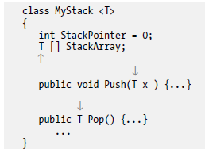
Generic Classes
Generic classes encapsulate operations that are not specific to a particular data type
Operations such as adding and removing items from the collection are performed in basically the same way regardless of the type of data being stored
Typically, you create generic classes by starting with an existing concrete class, and changing types into type parameters one at a time until you reach the optimal balance of generalization and usability
Continuing with Stack Example
Take the MyIntStack class declaration, and instead of substituting float for int, substitute the type placeholder T.
Change the class name
Place the string <T> after the class name.
Notes:
Show the transformation between the old code and the new one happened
Emphasis on the bullet points from second part of the slide

Slide 7
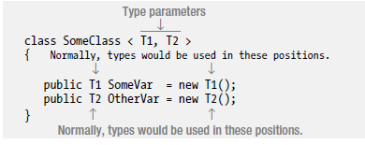
Generic Classes
Declaring generic classes is done using the following guidelines:
Place a matching set of angle brackets after the class name.
Between the angle brackets, place a comma-separated list of the placeholder strings that represent the types, to be supplied on demand. These are called type parameters.
Use the type parameters throughout the body of the declaration of the generic class to represent the types that should be substituted in.
Notes:
Emphasis on what we need to declare a class
Emphasis on “type parameters” keyword

Slide 8
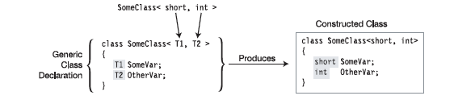
Generic Classes
You cannot create class objects directly from a generic class
To construct a class type from a generic class, list the class name and supply real types between the
angle brackets, in place of the type parameters.
The real types being substituted for the type parameters are called type arguments.
The compiler takes the type arguments and substitutes them for their corresponding type parameters throughout the body of the generic class, producing the constructed type—from which actual class instances are created.
Notes:
Emphasis on ‘type arguments’ vs ‘type parameters’
Explain how the compiles creates concrete classes from generic templates

Slide 9
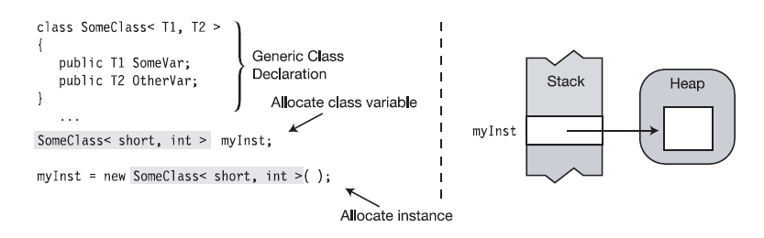
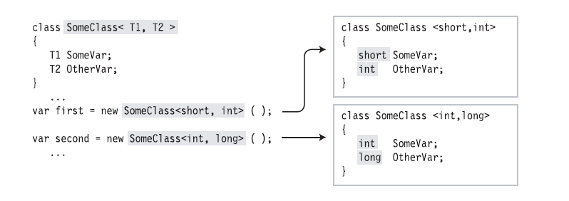
Creating Variables and Instances
Using a constructed type to create a reference and an instance:
Two constructed classes created from a generic class
Notes:
Explanation for using a constructed type to create a reference and an instance
The first line below the generic class declaration allocates a reference in the stack for variable myInst. Its value is null.
The second line allocates an instance in the heap and assigns its reference to the variable.
Explanation for constructing two classes from a generic class
One type is constructed with types short and int.
The other is constructed with types int and long.

Slide 10
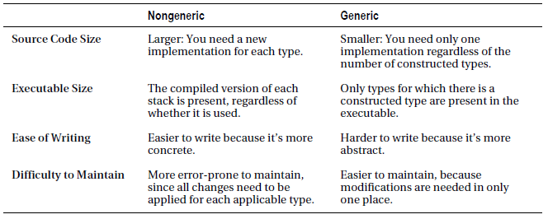
Comparing the Generic and Non-generic classes
From a source code size point of view we can say the non-generic way produces larger results than the generic method
In terms of size of executables, the compiled version of each class is present, regardless if it’s used or not; only types for which there is a constructed type get included in the executables
Non-generic classes tend to be easier to write but harder to maintain comparing to the generic classes
Notes:
Emphasis on advantages vs disadvantages between the two methods
Try to focus on how building generic classes implies a more abstract method of thinking

Slide 11

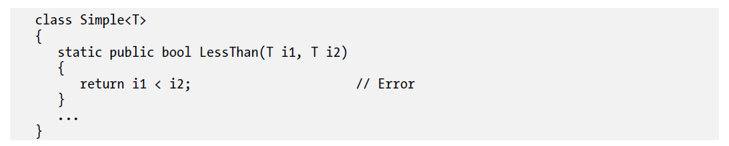
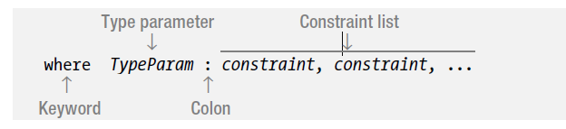
Constraints on Type Parameters
All C# objects are ultimately derived from class Object - > implement members like ToString, Equals, and GetType.
As long as your code doesn’t access the objects of the types it handles (or as long as it sticks to the members of type object), your generic class can handle any type. Type parameters that meet this constraint are called unbounded type parameters. If, however, your code tries to use any other members, the compiler will produce an error message.
To make generics more useful, you need to be able to supply additional information to the compiler about what kinds of types are acceptable as arguments. These additional bits of information are called constraints. Only types that meet the constraints can be substituted for the given type parameter.
Constraints are listed as where clauses:
Each type parameter that has constraints has its own where clause.
If a parameter has multiple constraints, they are listed in the where clause, separated by commas.
Notes:
Since type parameters don’t offer too much information regarding the actual type used we need to refine the way we can inform the compiler of the actual types to be supplied
Not creating any constraints will result in unbounded type parameters

Slide 12
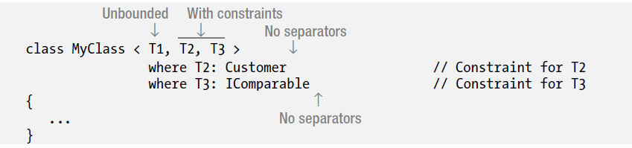
Where Clauses
The important points about where clauses are the following:
They’re listed after the closing angle bracket of the type parameter list
They’re not separated by commas or any other token
They can be listed in any order
The token where is a contextual keyword, so you can use it in other contexts
Notes:
How to create constraints
Syntax
Order
Keyword

Slide 13
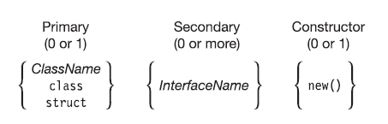
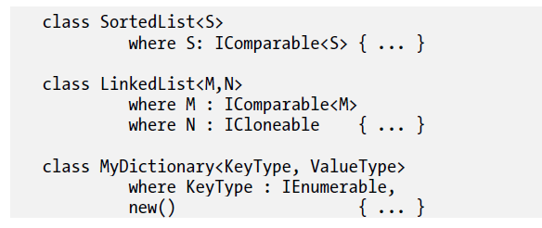
Constraint Types Order
The where clauses can be listed in any order.
The constraints in a where clause, however, must be placed in a particular order:
There can be at most one primary constraint, and if there is one, it must be listed first
There can be any number of InterfaceName constraints
If the constructor constraint is present, it must be listed last
Notes:
Speak about new() and order of the where constraints

Slide 14
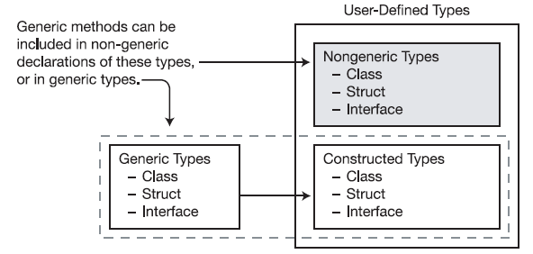
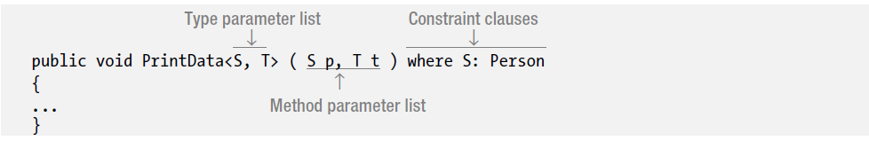
Generic Methods
Unlike the other generics, a method is not a type but a member. You can declare generic methods in
both generic and nongeneric classes, and in structs and interfaces.
Generic methods have two parameter lists:
The method parameter list, enclosed in parentheses
The type parameter list, enclosed in angle brackets
Notes:
Describe what generic methods are
In terms of declaring we apply the same rules as declaring generic classes
You can use an generic method in a concrete class

Slide 15
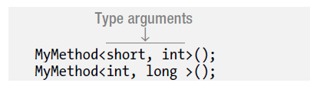
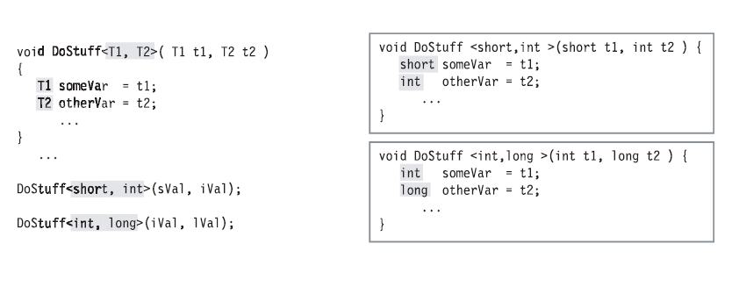
Invoking a Generic Method
To invoke a generic method, supply type arguments with the method invocation, as shown here:
A generic method with two instantiations
Notes:
Describe how generic methods get transformed into their corresponding concrete methods
Invoking generic methods is similar to invoking generic classes using angular brakets

Slide 16
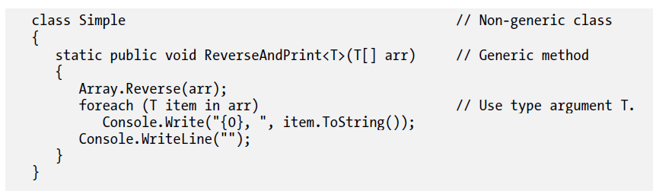
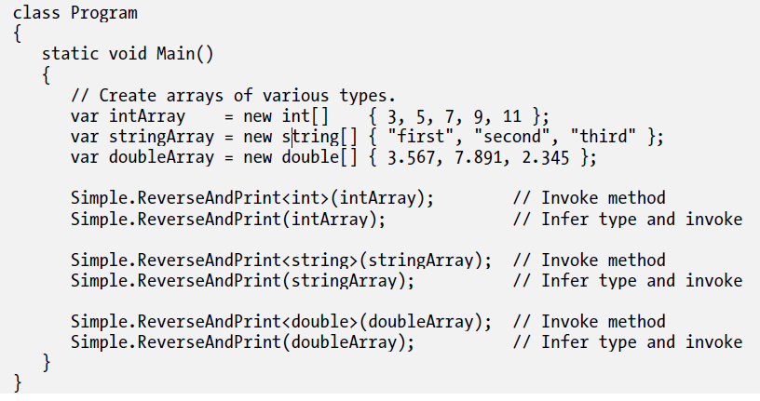
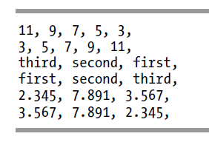
Example of a Generic Method
Notes:
-describe above code and how this generic method gets used in the main body
Infer types
Explain that if the method doesn’t have T as parameter, declaring in angular brackets is mandatory

Slide 17
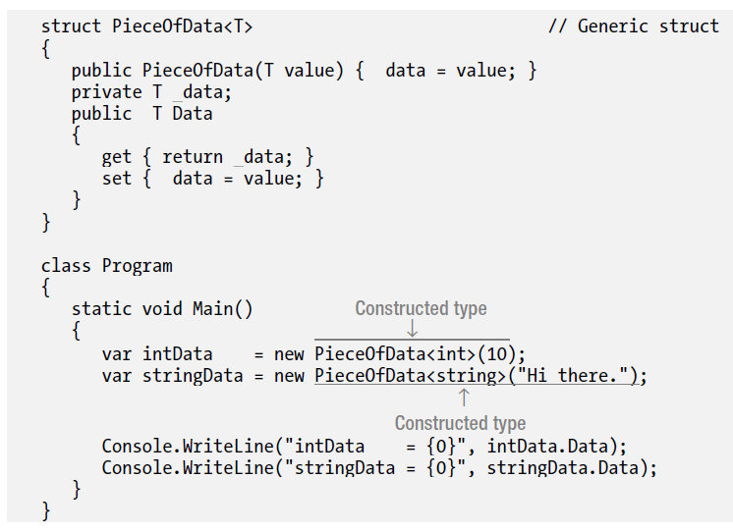
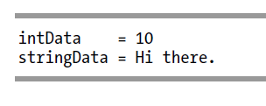
Generic Structs
Like generic classes, generic structs can have type parameters and constraints.
The rules and conditions for generic structs are the same as those for generic classes.
Notes:
Emphasis on the existing rules detailed before applies on structs as well
- Type parameters / type arguments , type constraints

Slide 18
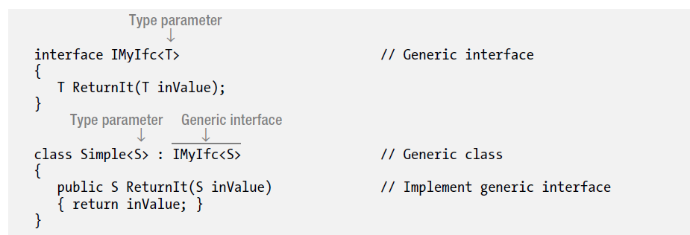
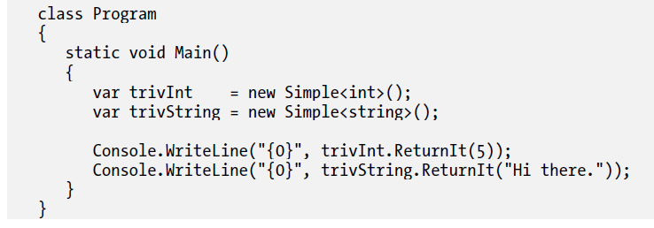
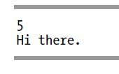
Generic Interfaces
Generic interfaces allow you to write interfaces where the formal parameters and return types of interface members are generic type parameters.
Generic interface declarations are similar to nongeneric interface declarations but have the type parameter list in angle brackets after the interface name.
Notes:
- Similar to how declaring and using generic classes

Slide 19
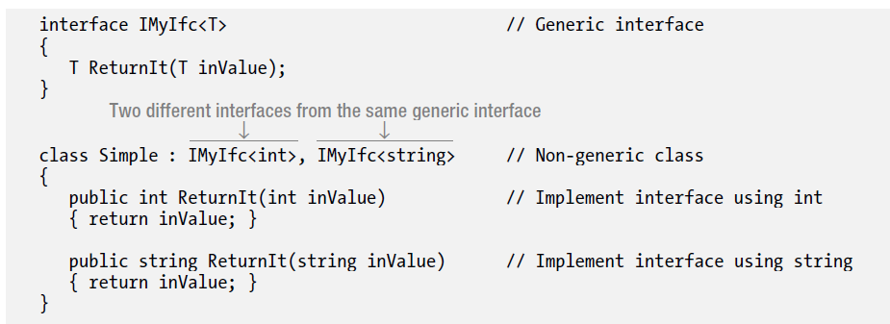
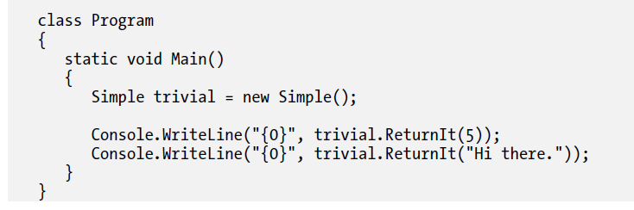
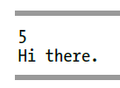
An Example Using Generic Interfaces
Two additional capabilities of generic interfaces:
Like other generics, instances of a generic interface instantiated with different type parameters are different interfaces.
You can implement a generic interface in a nongeneric type.
Notes:
Emphasis on the above example
How the concrete classes manages to implement same interface but with different type parameters

Slide 20
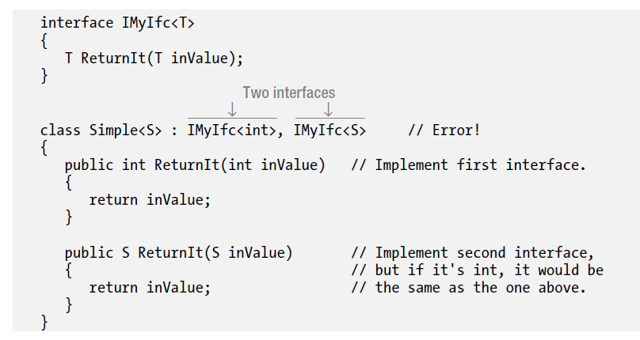
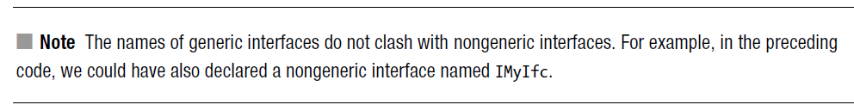
Generic Interface Implementations Must Be Unique
When implementing an interface in a generic type, there must be no possible combination of type arguments that would create a duplicate interface in the type.
constructed type, instantiated with type int
has a type parameter rather than an argument
Notes:
- Emphasis on the above example on why this approach does not work

Slide 21
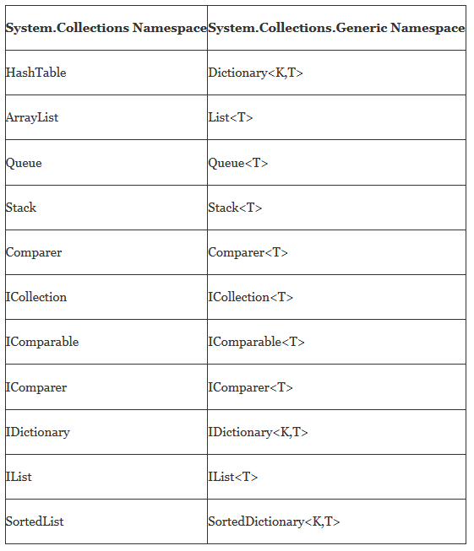
Generic Collections in C#

Slide 22
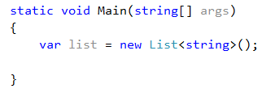
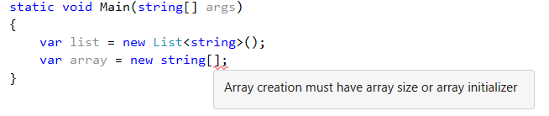
What is a Collection?
A way to group objects.
A collection is a class, so you must declare an instance of the class before you can add elements to that collection.
Tips & Tricks: Arrays are most useful for creating and working with a fixed number of strongly-typed objects.
Unlike arrays, the group of objects you work with can grow and shrink dynamically as the needs of the application change
Notes:
For many applications, you want to create and manage groups of related objects. There are two ways to group objects: by creating arrays of objects, and by creating collections of objects.
Collections provide a more flexible way to work with groups of objects. Unlike arrays, the group of objects you work with can grow and shrink dynamically as the needs of the application change. For some collections, you can assign a key to any object that you put into the collection so that you can quickly retrieve the object by using the key.

Slide 23
Types of collection
System.Collections.Generic
Class | Description
List<T> | Represents a list of objects that can be accessed by index. Provides methods to search, sort, and modify lists.
Queue<T> | Represents a first in, first out (FIFO) collection of objects.
Stack<T> | Represents a last in, first out (LIFO) collection of objects.
System.Collections
Class | Description
ArrayList | Represents an array of objects whose size is dynamically increased as required.
Hashtable | Represents a collection of key/value pairs that are organized based on the hash code of the key.
Queue | Represents a first in, first out (FIFO) collection of objects.
Stack | Represents a last in, first out (LIFO) collection of objects.
Notes:
You can create a generic collection by using one of the classes in the System.Collections.Generic namespace. A generic collection is useful when every item in the collection has the same data type. A generic collection enforces strong typing by allowing only the desired data type to be added.

Slide 24
Types of collection
How to choose the right collection to be used?
Interface | Scenario
IEnumerable, IEnumerable<T> | The only thing you want is to iterate over the elements in a collection. You only need read-only access to that collection.
ICollection, ICollection<T> | You want to modify the collection or you care about its size.
IList, IList<T> | You want to modify the collection and you care about the ordering and / or positioning of the elements in the collection.
List, List<T> | Since in object oriented design you want to depend on abstractions instead of implementations, you should never have a member of your own implementations with the concrete type List/List.
Notes:
List<T> is a specific implementation of IList<T>, which is a container that can be addressed the same way as a linear array T[] using an integer index. When you specify IList<T> as the type of the method's argument, you only specify that you need certain capabilities of the container.
Specify about FIFO, LIFO applied to Stack vs. Queue!!!

Slide 25
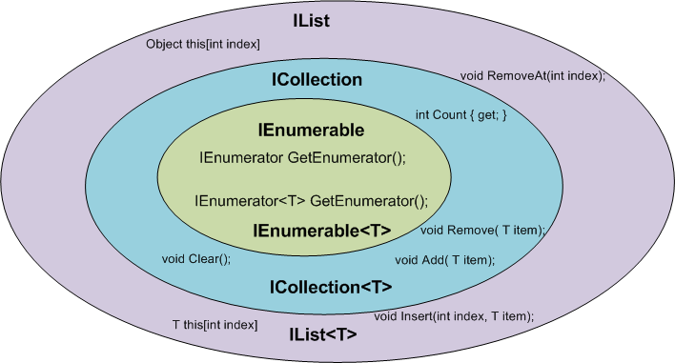
Interfaces vs. Concrete types
Tips & Tricks: Always use the Interfaces in method signatures, rather than the concrete implementation. This will reduce the implications on potential code changes
Notes:
For example, the interface specification does not enforce a specific data structure to be used. The implementation of List<T> happens to the same performance for accessing, deleting and adding elements as a linear array. However, you could imagine an implementation that is backed by a linked list instead, for which adding elements to the end is cheaper (constant-time) but random-access much more expensive. (Note that the .NET LinkedList<T> does not implement IList<T>.)
This example also tells you that there may be situations when you need to specify the implementation, not the interface, in the argument list: In this example, whenever you require a particular access performance characteristic. This is usually guaranteed for a specific implementation of a container (List<T> documentation: "It implements the IList<T> generic interface using an array whose size is dynamically increased as required.").
Additionally, you might want to consider exposing the least functionality you need. For example. if you don't need to change the content of the list, you should probably consider using IEnumerable<T>, which IList<T> extends.
- Driven by generic rules, please see tips and tricks

Slide 26
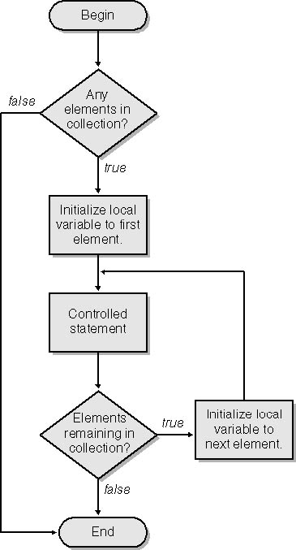
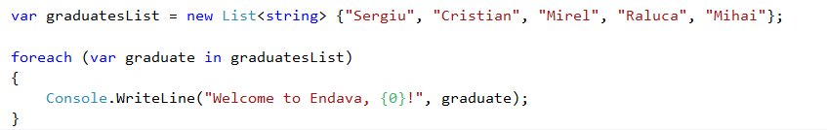
The foreach & yield statements
Tips & Tricks: For and foreach differ slightly in performance. They are approximately the same speed, but the foreach loop uses more stack space for local variables.
Notes:
Difference between for and foreach

Slide 27
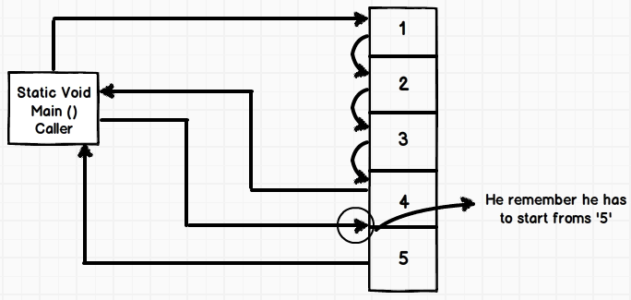
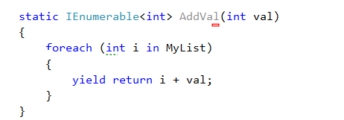
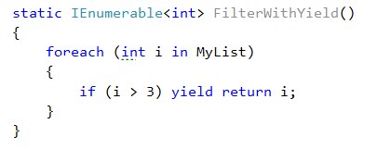
The foreach & yield statements
Notes:
When you use the yield keyword in a statement, you indicate that the method, operator, or get accessor in which it appears is an iterator. Using yield to define an iterator removes the need for an explicit extra class (the class that holds the state for an enumeration, see IEnumerator<T> for an example) when you implement the IEnumerable and IEnumerator pattern for a custom collection type.
Show the VS example
A yield return statement can't be located in a try-catch block. A yield return statement can be located in the try block of a try-finally statement.
A yield break statement can be located in a try block or a catch block but not a finally block.
An iterator block is a code block with one or more yield statements. Any of the following three types of
code blocks can be iterator blocks:
• A method body
• An accessor body
• An operator body
Iterator blocks are treated differently than other blocks. Other blocks contain sequences of
statements that are treated imperatively. That is, the first statement in the block is executed, followed by
the subsequent statements, and eventually control leaves the block.
An iterator block, on the other hand, is not a sequence of imperative commands to be executed at
one time. Instead, it’s declarative; it describes the behavior of the enumerator class you want the
compiler to build for you. The code in the iterator block describes how to enumerate the elements.
Iterator blocks have two special statements:
• The yield return statement specifies the next item in the sequence to return.
• The yield break statement specifies that there are no more items in the sequence.
The compiler takes this description of how to enumerate the items and uses it to build an
enumerator class, including all the required method and property implementations. The resulting class
is nested inside the class where the iterator is declared.

Slide 28
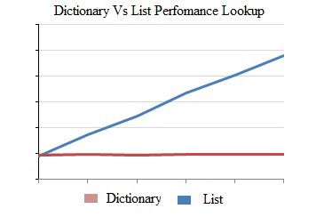

Dictionaries
Represents a collection of keys and values.
Notes:
Key is unique

Slide 29
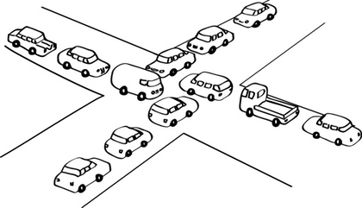
Concurrent collections
The System.Collections.Concurrent namespace provides several thread-safe collection classes that should be used in place of the corresponding types in the System.Collections and System.Collections.Generic namespaces whenever multiple threads are accessing the collection concurrently.
Class | Description
ConcurrentDictionary<TKey, TValue> | Represents a thread-safe collection of key/value pairs that can be accessed by multiple threads concurrently.
ConcurrentQueue<T> | Represents a thread-safe first in-first out (FIFO) collection.
ConcurrentStack<T> | Represents a thread-safe last in-first out (LIFO) collection.

Slide 30

Meta-data and Reflection
When you look in a mirror :
You can see your reflection
You can act on what you see, for example, straighten your tie
In computer programming :
Reflection is infrastructure enabling a program to see and manipulate itself
It consists of metadata plus operations to manipulate the metadata
Notes:
Most programs are written to work on data. They read, write, manipulate, and display data. (Graphics
are a form of data.) For some types of programs, however, the data they manipulate is not numbers, text,
or graphics, but information about programs and program types.
• Data about programs and their classes is called metadata and is stored in the
programs’ assemblies.
• A program can look at the metadata of other assemblies or of itself, while it’s
running. When a running program looks at its own metadata, or that of other
programs, it’s called reflection.
An object browser is an example of a program that displays metadata. It can read assemblies and
display the types they contain, along with all the characteristics and members.
This chapter will look at how your programs can reflect on data using the Type class and how you
can add metadata to your types using attributes.

Slide 31

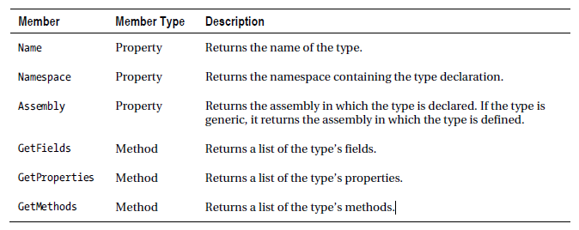

The Type Class
Notes:
The BCL declares an abstract class called Type, which is designed to contain the characteristics of a
type. Using objects of this class allows you to get information about the types your program is using.
Since Type is an abstract class, it cannot have actual instances. Instead, at run time, the CLR creates
instances of a class derived from Type (RuntimeType) that contains the type information. When you access
one of these instances, the CLR returns a reference, not of the derived type but of the base class Type. For
simplicity’s sake, though, throughout the rest of the chapter, I’ll call the object pointed at by the
reference an object of type Type, although technically it’s an object of a derived type that is internal to
the BCL.
Important things to know about Type are the following:
• For every type used in a program, the CLR creates a Type object that contains the
information about the type.
• Every type used in a program is associated with a separate Type object.
• Regardless of the number of instances of a type that are created, there is only a
single Type object associated with all the instances.

Slide 32
The Type Class
Type.GetMethods()
Returns all the public methods of the current Type.
Type.GetInterfaces()
Returns all the interfaces implemented or inherited by the current Type.
Type.GetProperties()
Returns all the public properties of the current Type.
Activator.CreateInstance()
Creates an instance of the specified type using that type's default constructor.
Notes:
The GetMethods method does not return methods in a particular order, such as alphabetical or declaration order. Your code must not depend on the order in which methods are returned, because that order varies.
Constructors are not included in the array of methods returned by this call. Make a separate call to GetConstructors() to get the constructor methods.
The following table shows what members of a base class are returned by the Get methods when reflecting on a type.

Slide 33
What Is an Attribute
An attribute is a language construct that allows you to add metadata to a program’s assembly. It’s a special type of class for storing information about program constructs.
Some important things to know about attributes are the following:
You apply an attribute by placing an attribute section immediately before the
construct.
An attribute section consists of square brackets enclosing an attribute name and
sometimes a parameter list.
Most attributes apply only to the construct immediately following the attribute
section or sections.
A construct with an attribute applied to it is said to be decorated, or adorned, with
the attribute. Both terms are common.

Slide 34
Predefined Attributes
The predefined attributes have been defined by Microsoft as a part of .NET FCL, and many of them receive special support from the C# compiler. Which implies that for those specific attributes, the compiler could customize the compilation process in a specific way.
The System.Attribute base class library provides a number of attributes in various namespaces.
The Obsolete Attribute
The Caller Information Attributes
The Serializable Attribute
Etc.

Slide 35
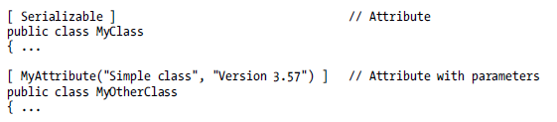
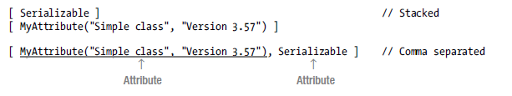
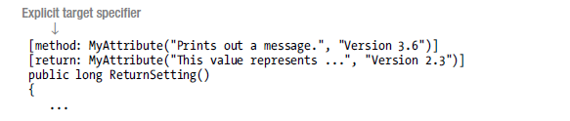
Applying attributes
Notes:
For example, the following code shows the headings of two classes. The first few lines of code show
an attribute named Serializable applied to class MyClass. Notice that Serializable has no parameter
list. The second class declaration has an attribute called MyAttribute, which has a parameter list with
two string parameters.
Multiple Attributes
You can apply multiple attributes to a single construct.
• Multiple attributes can be listed in either of the following formats:
− Separate attribute sections, one after another. Usually these are stacked on
top of each other, on separate lines.
− A single attribute section, with the attributes separated by commas.
• You can list the attributes in any order.
For example, the following code shows the two ways of applying multiple attributes. The sections of
code are equivalent.

Slide 36

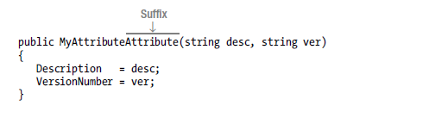

Attributes class
Some important points about attribute classes are the following:
• User-defined attribute classes are called custom attributes
• All attribute classes are derived from class System.Attribute
Notes:
You’ve probably noticed that the syntax for applying an attribute is very different from anything you’ve
seen so far. From that, you might get the impression that attributes are an entirely different type of
construct. They’re not—they’re just a special kind of class

Slide 37


Attributes class
MyAttribute must be applied only to classes.
MyAttribute is not inherited by classes derived from classes to which it is applied.
There cannot be multiple instances of MyAttribute applied to the same target.

Slide 38


Slide 39
Reading
https://drive.google.com/file/d/0B7iUmPNOEykISGtFbkZ0UW5aQkE/view
Chapter 12: Arrays
Chapter 17: Generics
Chapter 18: Enumerators and Iterators
Chapter 24: Reflection and Attributes
Exercises
https://docs.google.com/document/d/1WP3Q57DzN3qQxtyd96FJXh7Cjz00kR4ybbVmpn_EL6U/edit?usp=sharing

Slide 40
Thank you! ☺
Dumitru Miron
Application Support Engineer / .NET developer
email: dumitru.miron@endava.com
Skype id: en_dmiron

